Slide 1
Drop down menu

Slide 2
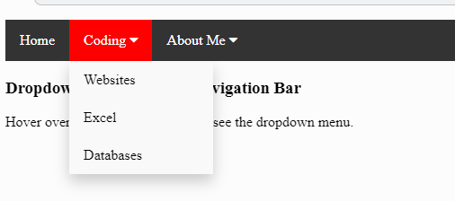
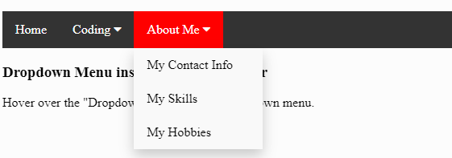
https://replit.com/@JohnGlazebrook/drop-down-menu#index.html

Slide 3
Step 1
Add the new CSS into your website
Copy the file
Into your website directory

Slide 4
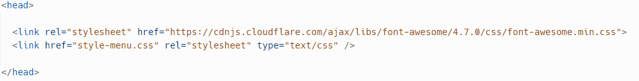
Use this style in your web page:
<link rel="stylesheet" href="https://cdnjs.cloudflare.com/ajax/libs/font-awesome/4.7.0/css/font-awesome.min.css">
<link href="style-menu.css" rel="stylesheet" type="text/css" />

Slide 5
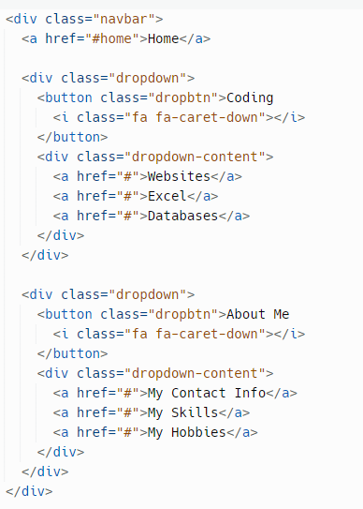
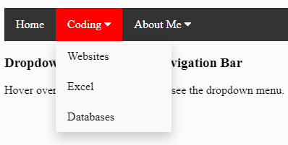

Slide 7
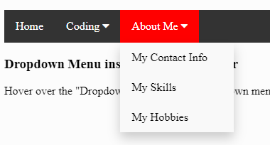

Slide 8


Slide 9
https://www.w3schools.com/howto/tryit.asp?filename=tryhow_css_dropdown_navbar
https://www.freecodecamp.org/news/how-to-build-a-dropdown-menu-with-javascript/
https://codepen.io/evavic44/pen/eYKQJjJ
https://boxicons.com/

